Slide 1
TMI -101: Tinkering Part
USING AI TO DETECT WASTE IN AN IMAGE
Chaitanya Kumar- 23116026
Nithish Ravikkumar- 23123028
Poojan Bansal- 23115105
Sparsh Gautam- 23116094
Faculty Supervisor/Advisor:
Prof. Bhanu Prakash
Project Implemented at:
Civil Engineering

Slide 2
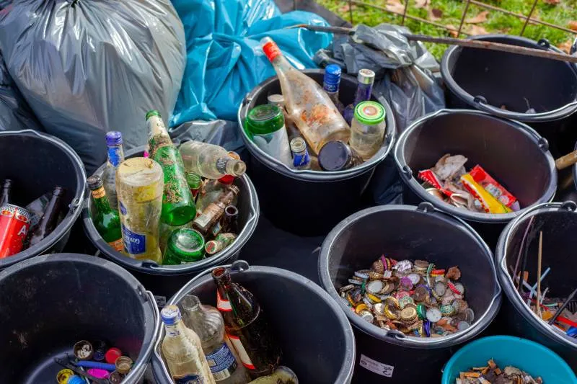
Understanding of the Problem
Introduction to the problem
The world is facing an unprecedented global waste crisis. With the increasing population and urbanization, our planet is struggling to manage the massive amount of waste generated daily.
For recycling of waste, it needs to be classified into its types, i.e, biodegradable and non-biodegradable, and further on the basis of materials, size and other properties.

Slide 3
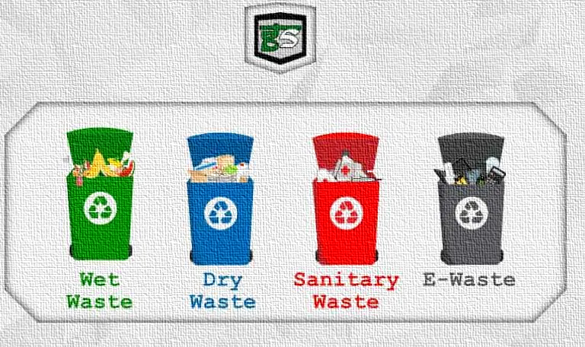
Waste segregation can reduce 25000 tonnes of waste from entering landfills in India every day.
Hence, we need to develop an automated system which can classify waste and sort them accordingly.
This work cannot be done manually as it is time-consuming as well as of hazardous nature.

Slide 4
Understanding the Problem
Project Goal
Our project aims to address the global waste crisis by developing an AI-based waste detection system.
By harnessing the power of artificial intelligence, we aspire to improve waste management and recycling processes, ultimately contributing to a more sustainable future.
This project is a part of bigger goal: to develop an automated system for waste segregation. It will consist of mechanical parts guided by this AI model to separate recyclable, and non-recyclable waste.

Slide 5
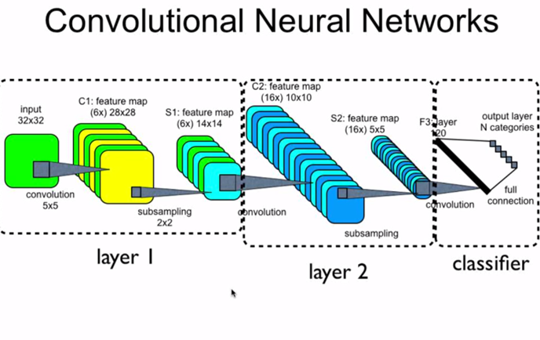
Approach Adopted for Project
By using a CNN model in our waste detection project and following these steps, we can leverage the power of deep learning to accurately identify and classify waste materials, thereby improving waste management processes and sustainability efforts.
In this project, we are going to set up and configure a deep learning model for image classification using TensorFlow and Keras.
In this project, we are using PARAM GANGA Supercomputer and its
high computational power to evaluate the large amount of data on waste materials.

Slide 6
Here's a summary of the key components and steps in our code:
Gather a diverse dataset of waste images or videos, including various types of waste materials and environmental conditions.
Data preprocessing, resizing of images and one-hot encoding of labels for categorical classification.
Applying Data augmentation techniques to increase the diversity of the dataset.
Train the CNN model using the training data, optimizing a suitable loss function.
Using Matplotlib to create static, animated, and interactive data visualisations.
Evaluate the model's performance on the test dataset using metrics like accuracy, precision, recall, and F1-score.

Slide 7
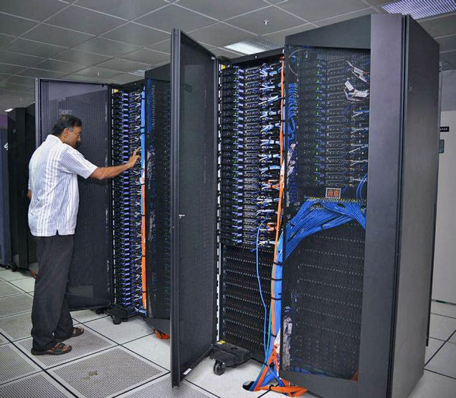
PARAM GANGA manual
Log in to the Param Ganga server remotely, using Mobaxterm.
Import your files into Param Ganga from your local disk.
Job creation, optimization and implementing algorithm.
Training and testing of created AI model.
Retrieval of final results for analysis to local machine.
Resource cleanup and disconnection from
server.

Slide 8
Summary of Current Progress
Developed an algorithm for classification of waste from images.
Connected to Supercomputer PARAM-GANGA to make use of its advanced capabilities.
Trained the AI model on a dataset of 25000 images.
Current accuracy of image classification= 92%

Slide 9
THANK YOU

